Slide 1
Fake News Detection Using Machine Learning
Mentor: Dr. Manoj Kumar Gupta
Abhinav Maurya 19bcs003 Abheet Kumar 19bcs002 Shri Mata Vaishno Devi University , Katra , J&K

Slide 2
Presentation Outline
Introduction Related Research Research Problem and Objectives Research Methodology Proposed Solution Experimental Setup and Results
References Conclusions

Slide 3

Introduction
Fake news detection continues to receive rising focus from research communities and industry professionals .

Slide 4
A type of yellow journalism, fake news encapsulates pieces of news that may be hoaxes and is generally spread through social media and other online media. This is often done to further or impose certain ideas and is often achieved with political agendas. Such news items may contain false and/or exaggerated claims, and may end up being viralized by algorithms, and users may end up in a filter bubble.

Slide 5
Major transmission of fake news has negative impact on both individuals and society. Uncovering fake reviews on social media is decisive and technically challenging . Human eye cannot precisely differentiate between true and false text, so need for automated system .

Slide 6
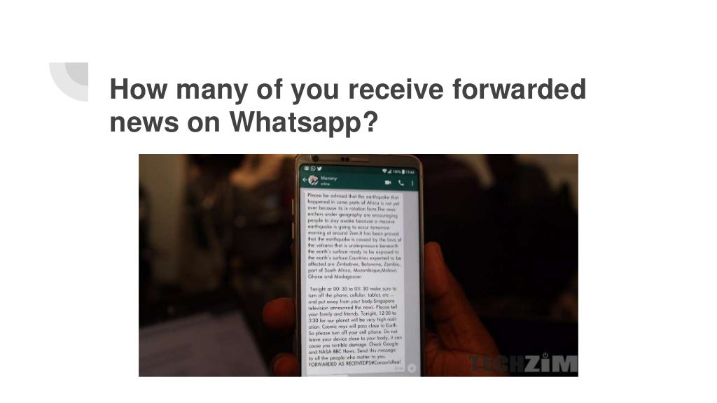

Slide 7
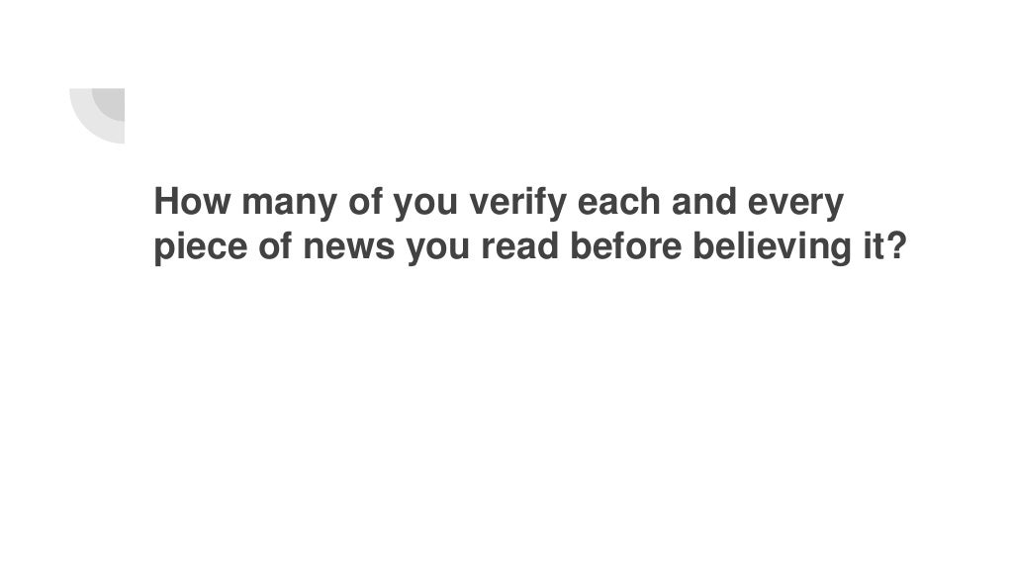

Slide 8
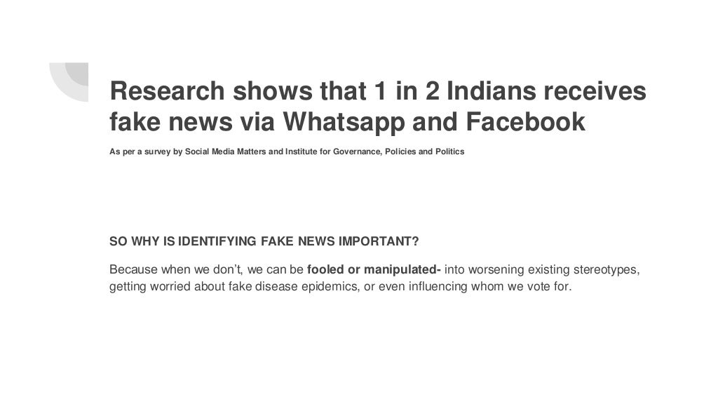
YOU CAN ALSO SPLIT YOUR CONTENT

Slide 9
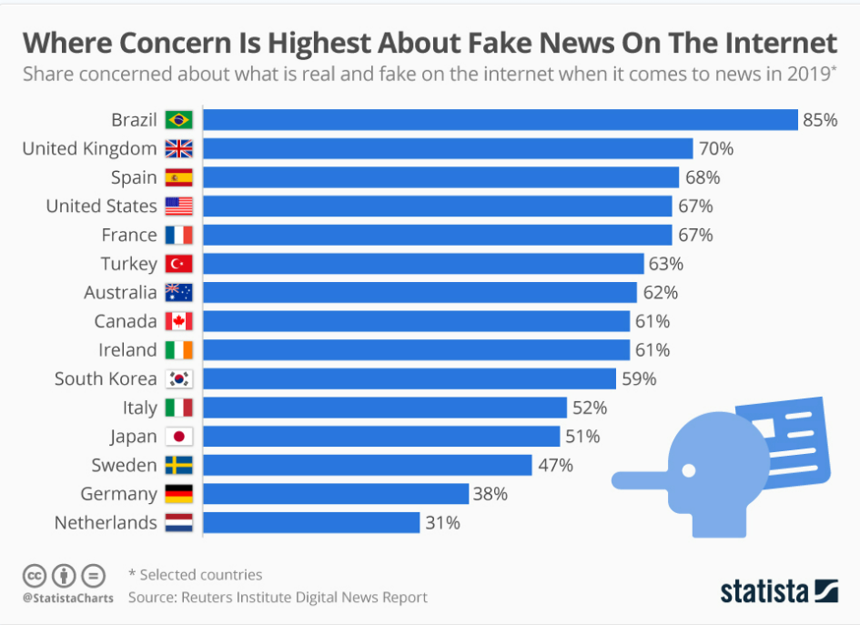


Slide 10


Significance of Work
Using social media as a medium for news updates is a double-edged sword.
social media
provides for easy access, little to no cost, and the spread
of information at an impressive rate
social media
provides the ideal place for the creation and spread of fake news

Slide 11
Significance of Work contd..
Misinformation can be difficult to correct and may have lasting implications.
since false information is able to spread so fast, not only does it have the ability to harm people, but it can also be detrimental to huge corporations and even the stock market.
October of 2008, a false report that Steve Jobs had a heart attack.
humans are very poor lie detectors and lack the realization that there is the possibility they are being potentially lied to.
Users tend to let their guard down on social media and potentially absorb all the false information as if it were the truth.

Slide 12
Related Research
Amazon, continues to sue individuals and companies, which offer to post untruthful reviews on behalf of sellers as a paid service (Kieler et al., 2016)
Issue with applying classification methods to detect fake text is dearth of ground truth datasets (Aghakhani et al., 2015)
Rubin et al., 2015 stated that there are different kinds of fake news, each with potential textual indicators
Ott et al., 2014 designed a multi-domain dataset by asking Turkers to pen down fake reviews
Qazvinian et al., 2011 utilized unigram, bigram and part-of-speech (PoS) features of tweets to detect rumour
Liu et al., 2006 stated that text classification is a construction problem of models that can classify new documents into pre-defined classes .

Slide 13
Related Research
Ren et al., 2017 stated that Convolutional Neural Network (CNN) provides best representation for sentence and Gated Recurrent Unit (GRU) provides best representation for document.

Slide 14
Research Problem and Objectives
Research Problem
For a given text coming from different online sources such as news, reviews, posts, tweets or blogs, the task is to figure out if it is a fake or real text. using various classification Machine Learning Methods. Research Objectives To find out which classification Algo is best Suited. To check the performance of machine learning models. Figure out best text representations methods and their impact on classification metrics.

Slide 15
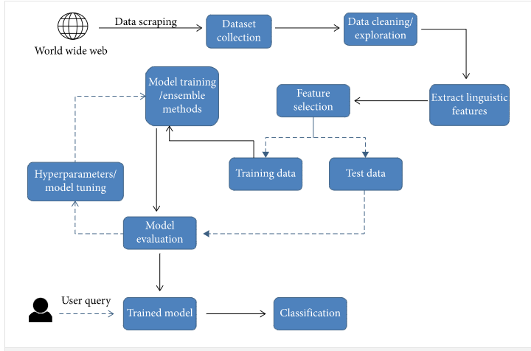
Proposed Solution (Process View)

Slide 16
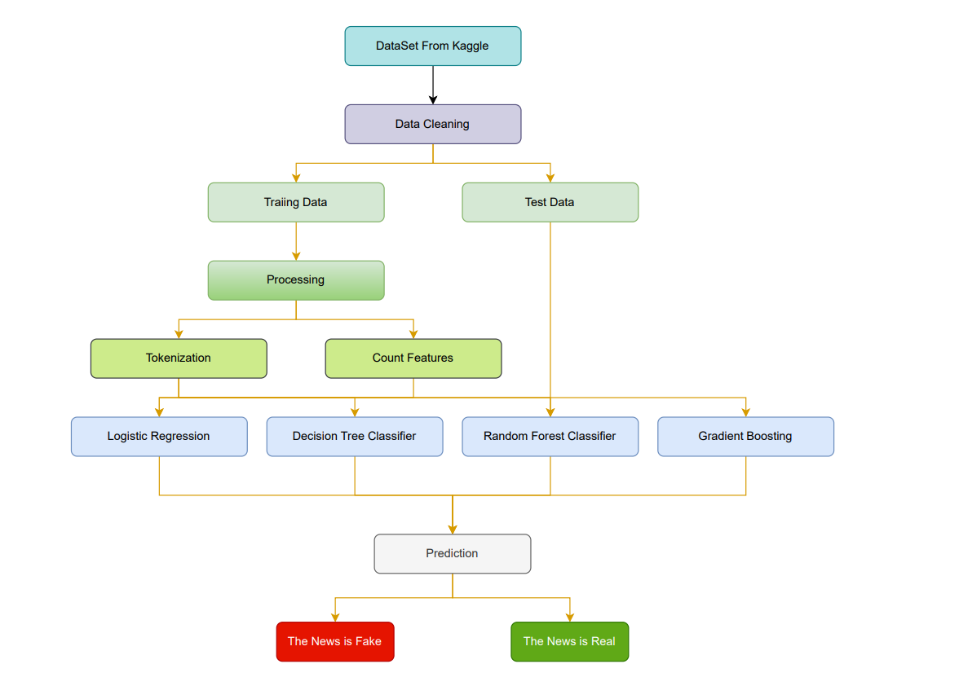
Workflow Diagram

Slide 17
Experimental Setup and Results First one 4000 records, second one 1600 records and third one 7500 records. 2 attributes – News text and News label (fake or real) or Review text and Review label (fake or real) or Tweet text and Tweet label (fake or real) used in data analysis Confusion matrix for fake news, reviews and tweets for different text representations created and compared Different models and classification metrics for fake news, reviews and tweets compared Receiver Operating Characteristics curves created for fake news, reviews and tweets

Slide 18
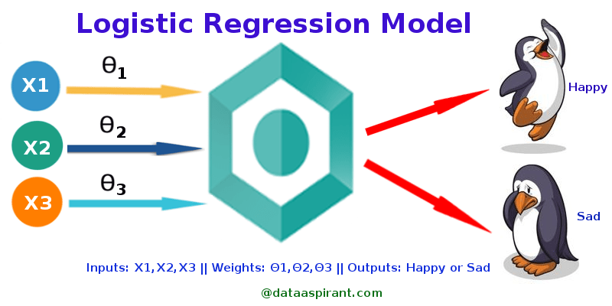
1. Logistic Regression
Logistic regression is a process of modeling the probability of a discrete outcome given an input variable.

Slide 19
Logistic Regression was used in the biological sciences in early twentieth century. It was then used in many social science applications. Logistic Regression is used when the dependent variable(target) is categorical.
For example,
To predict whether an email is spam (1) or (0)
Whether the tumor is malignant (1) or not (0)
Here in our case we have to classify the given news is either fake or true .
Here we will be using-
Binary Logistic Regression
The categorical response has only two 2 possible outcomes. Example: Fake news or True news.

Slide 20
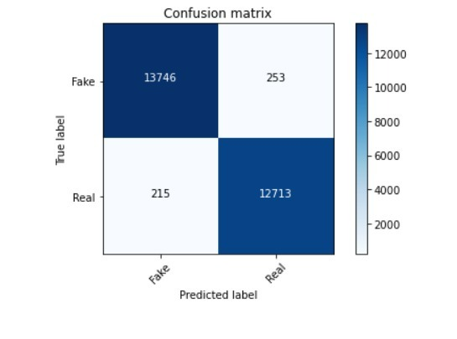
Confusion Matrix for Logistic Regression

Slide 21
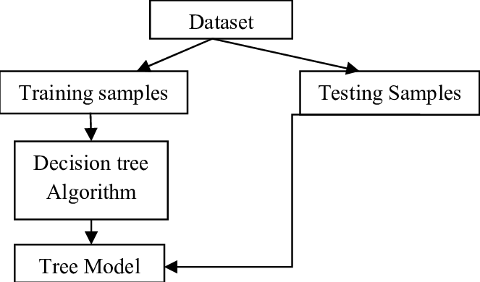
2. Decision Tree Classification
Decision Tree is a Supervised Machine Learning Algorithm that uses a set of rules to make decisions, similarly to how humans make decisions.
Decision tree builds classification or regression models in the form of a tree structure. It breaks down a dataset into smaller and smaller subsets while at the same time an associated decision tree is incrementally developed.

Slide 22
Decision trees can perform both classification and regression tasks.
The intuition behind Decision Trees is that you use the dataset features to create yes/no questions and continually split the dataset until we isolate all data points belonging to each class. With this process we’re organizing the data in a tree structure.
Every time we ask a question you’re adding a node to the tree. And the first node is called the root node.
The result of asking a question splits the dataset based on the value of a feature, and creates new nodes.
If we decide to stop the process after a split, the last nodes created are called leaf nodes.
A decision tree is made up of decision nodes that start at the top and work their way down.
Dependent characteristics,
No need for linear class separation,
Fast management of outliers, and intuitive decision tree interpretation are all
advantages of employing a decision tree.
When there are a significant number of sparse features, however, a decision
tree will overfit and perform poorly on the testing data

Slide 23
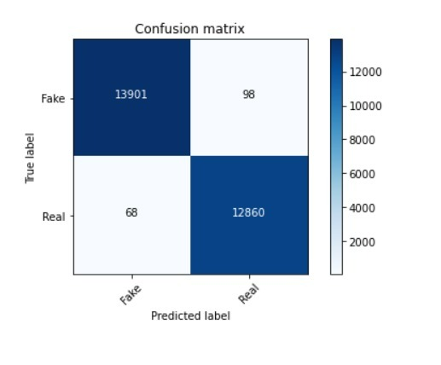
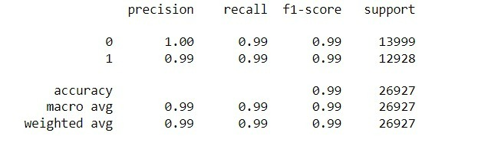
Results for Decision Tree Classification

Slide 24
3. Gradient Boosting Classifier
A gradient boosting classifier is used when the target column is binary.
Gradient boosting classifiers are a group of machine learning algorithms that combine many weak learning models together to create a strong predictive model.

Slide 25
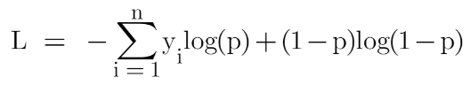
Gradient boosting creates an ensemble of weak prediction models, usually decision trees, as a prediction model. The resulting technique is called gradient boosted trees when a decision tree is a weak learner, and it usually outperforms random forest. It constructs the model in the same stage-by-stage manner as other boosting approaches, but it broadens the scope by allowing optimization of any differentiable loss function.
The Gradient Boosting Classifier depends on a loss function. A custom loss function can be used, and many standardized loss functions are supported by gradient boosting classifiers, but the loss function has to be differentiable.
Classification algorithms frequently use logarithmic loss .
The loss function for the classification problem is given below:

Slide 26
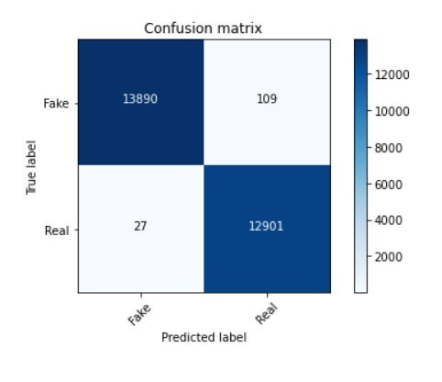
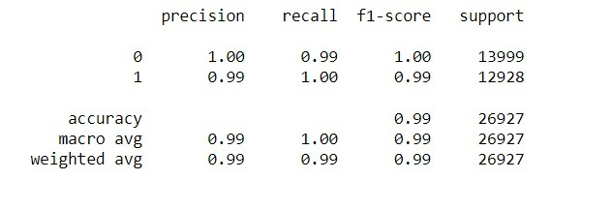
Results for Gradient Boosting Classifier

Slide 27
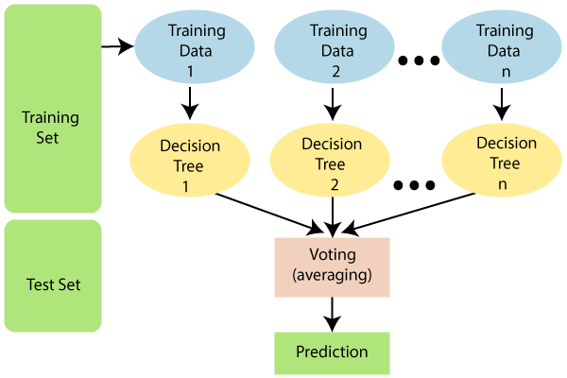
4. Random Forest Classifier
Random Forest is a classifier that contains a number of decision trees on various subsets of the given dataset and takes the average to improve the predictive accuracy of that dataset."
Random forest builds multiple decision trees and merges them together to get a more accurate and stable prediction. One big advantage of random forest is that it can be used for both classification and regression problems, which form the majority of current machine learning systems.

Slide 28

Many decision trees are built by the random forest algorithm. Utilizing a subset of features, each decision tree is created. Each decision tree produces one class and eventually bootstraps the votes to obtain better accuracy from the Random Forest technique. A tree-shaped pattern is used to describe the plan of action in a decision tree. At any node, a decision will be made.
Random forest, like its name implies, consists of a large number of individual decision trees that operate as an ensemble. Each individual tree in the random forest spits out a class prediction and the class with the most votes becomes our model’s prediction.
the prerequisites for random forest to perform well are:
There needs to be some actual signal in our features so that models built using those features do better than random guessing.
The predictions (and therefore the errors) made by the individual trees need to have low correlations with each other.

Slide 29
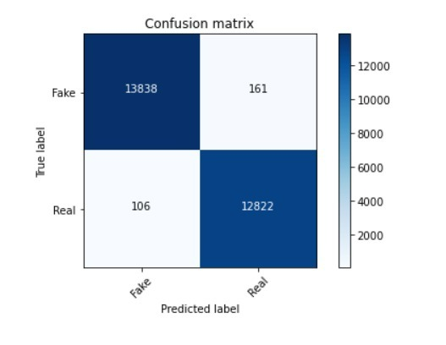
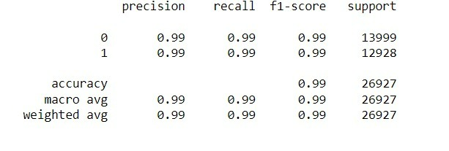
Results for Random Forest Classifier

Slide 30
Implementation and Results

Slide 31
Implementation
For implementation and better result purpose we took two dataset which is CSV file we took it from Kaggle web sites and taken dataset consist of true csv and false csv which have more than 20,000 news which were mixed together to form a csv file that contain both true and false news . here below is the screenshot of the user interface

Slide 32
Further, a Jupyter Notebook was created to implement the ML program. We have used Logistic Regression, Gradient Boosting, Decision Tree, and Random Forest. After TF-IDF vectorization and cleaning the data we train and test them according to these classifiers we got the accuracy for , Decision Tree as 98%, Gradient Boosting as 98.44%, Random Forest as 99.1% .

Slide 33
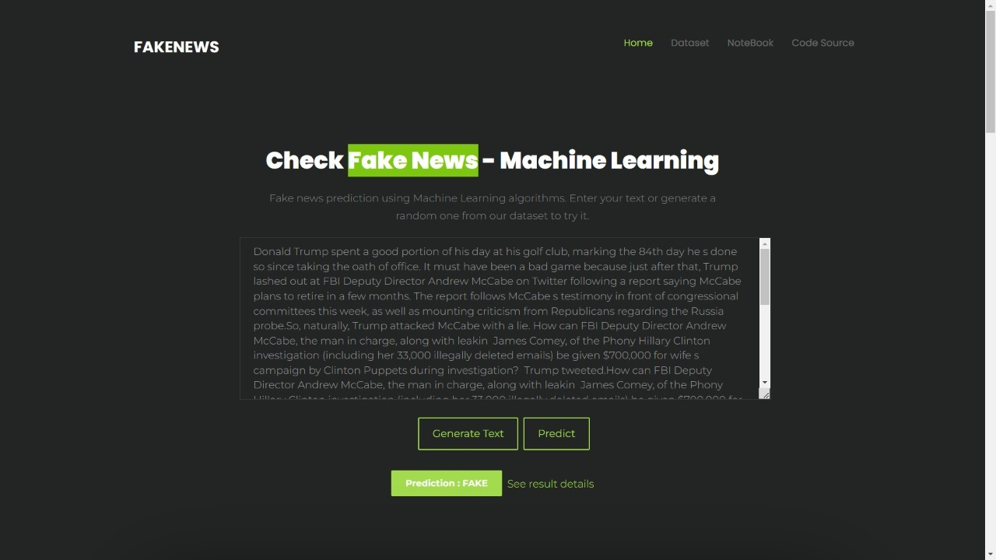
User - Interface

Slide 34
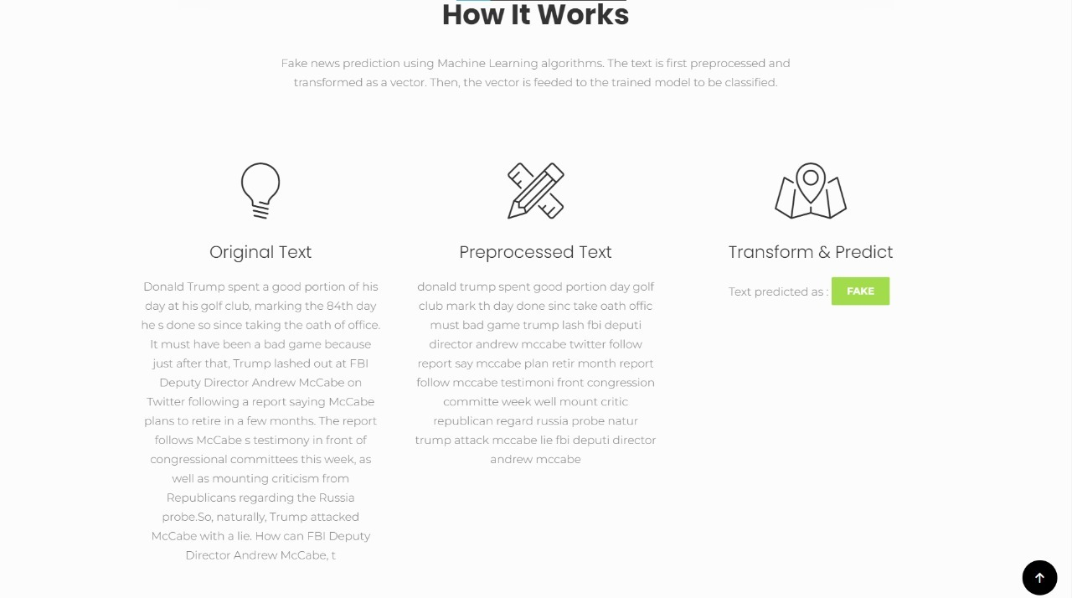
Working of Prediction Model

Slide 35
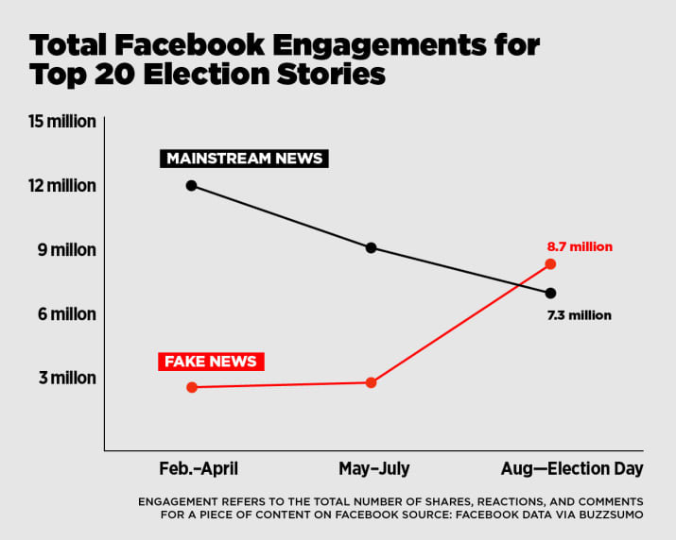
Real World Applications
1. Elections
2. Fake job Rackets
3.Checking the credibility of news link received on WhatsApp, Facebook , Twitter.
4.Fake Medical news messages.

Slide 36

Real World Implementation
1. To implement this in real life, we can make a mobile app or a WhatsApp-integrated feature.
2.Users would simply enter the link of a news website and be able to verify whether a news website is true or fake .
3. In the future, our improved model could also consider individual news stories and not just the news website as a whole.

Slide 37
Conclusion
Online businesses capitalize on machine learning models to find out if a text is fake or real. They can use the proposed hybrid deep learning model for fake text identification Regulation is required by governments to stop the advancement of fake texts. This will need appropriate public policy changes If fake texts are controlled then market fluctuations will be less, leading to a stable economic environment Data Analytics is the enabler to solve this critical business problem of distinguishing between fake and real texts with high predictive accuracy, hence assisting the policy makers, businesses, communities, consumers and society

Slide 38
References
DataSet Fake News Prediction | Kaggle
https://paperswithcode.com/paper/fake-news-detection-with-different-models/review/
https://www.researchgate.net/publication/347634807_FAKE_NEWS_DETECTION_USING_SUPERVISED_LEARNING_METHOD
https://www.mdpi.com/2079-9292/11/8/1255/htm
https://www.youtube.com/watch?v=tdFMIO5lfgA
https://www.youtube.com/watch?v=Pwp7KaWJ0XQ

Slide 39



